Slide 1
SECURE DATA HIDING IN IMAGES USING STEGANOGRAPHY
CAPSTONE PROJECT
Presented By: Sai Spoorthi Depa
Student Name : Sai Spoorthi Depa
College Name & Department : Mina Institute of Engineering and Technology for Women Computer Science and Engineering Department

Slide 2
OUTLINE
Problem Statement
Technology used
Wow factor
End users
Result
Conclusion
Git-hub Link
Future scope

Slide 3
Problem Statement
Develop a data hiding technique using Steganography to conceal sensitive information within digital images, ensuring secure transmission and storage while maintaining image integrity

Slide 4
Technology used
Programming language: The primary technologies used in this project include Python programming language.
Libraries: CV2 library and string library used here CV library was used for manipulating and processing digital images and string library provided a collection of string operations, constants, and methods that are useful for manipulating and working with strings.
Platform: The project was developed and executed using Python IDLE, which provided an interactive environment for writing and running code.

Slide 5
Wow factors
Invisibility: steganography hides existence of the data itself. This makes it particularly useful for covert communication
Enhanced Security: Steganography adds an extra layer of security, protecting sensitive information from unauthorized access
Low Detection Risk: Steganographic methods aim to make the hidden data inconspicuous to the naked eye, reducing the risk of detection compared to encrypted data.

Slide 6
End users
Individuals: To share sensitive information privately, such as personal documents or messages.
Businesses: To protect their business secrets and important communication from competitors or unauthorized access.
Government Agencies: To communicate intelligence, national security information, and other classified data with out drawing attention
Software Developers: To enhance security features within applications by incorporating steganographic techniques.

Slide 7
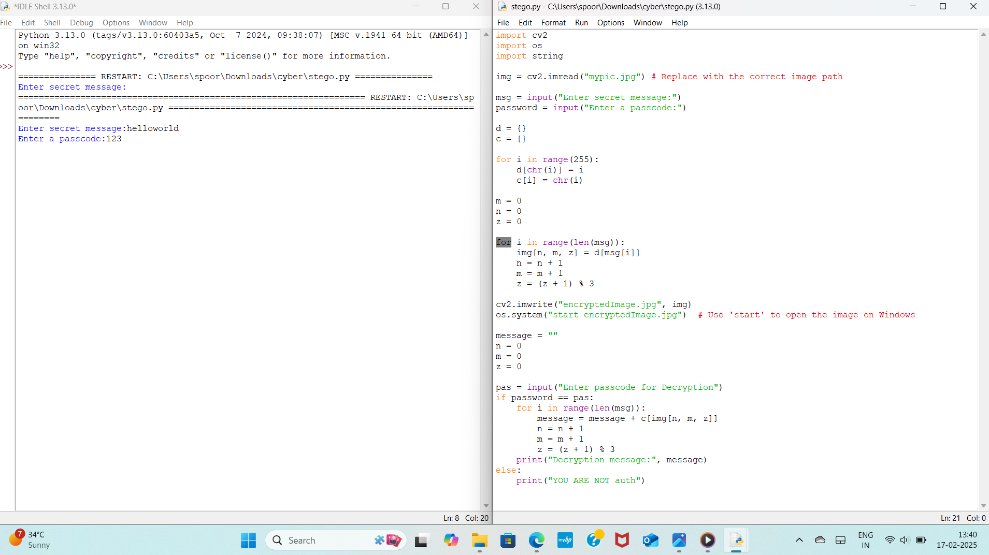
Results

Slide 8
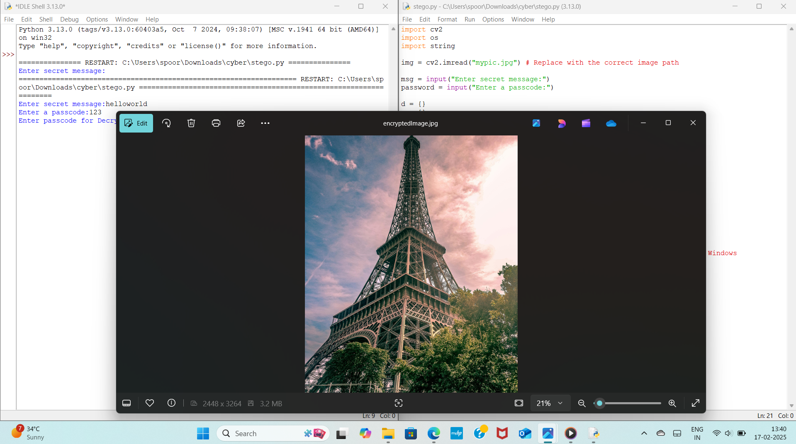

Slide 9
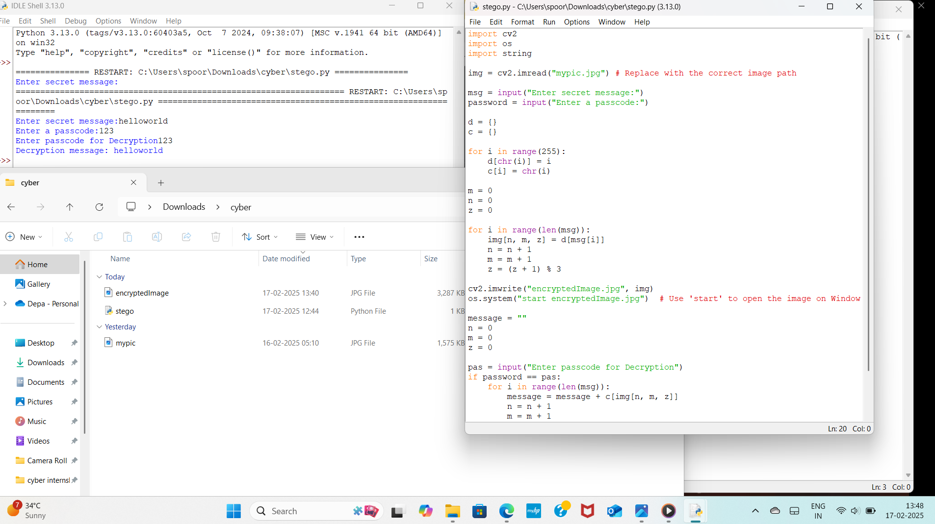

Slide 10
Conclusion
Developed a data hiding technique using Steganography to conceal sensitive information within digital images, ensuring secure transmission and storage while maintaining image quality and integrity

Slide 11
GitHub Link
https://github.com/Spoorthi600/AICTE_EDUNET.git

Slide 12
Future scope(optional)
Future scope of this steganography is in cybersecurity, artificial intelligence and social media

Slide 13
THANK YOU

